Slide 1
Cloud Computing: Storage as a Service
Vijay Dialani, PhD
Boise State University
vijaydialani@boisestate.edu
©All rights reserved by the author

Slide 2
Storage
It is one of the easiest resource to monitor and virtualize
Units of measures are well understood (bytes, KB, MB, GB, TB ….)
Easy to name (URI) and organize (File Collections)
Easy to monitor
Easy to partition and share between users
Is a non-volatile resource
Challenges
How to make it reliable in a system that has failing components?
How to make it scale and attain high throughput?
As of 2012, S3 storage service stored a total of 1.3 trillion objects and handles over 830,000 requests per second.

Slide 3
Three dimensions of Cloud Storage
Are these metrics tunable?
What are the trade-offs?
Performance
Reliability
Storage Costs

Slide 4
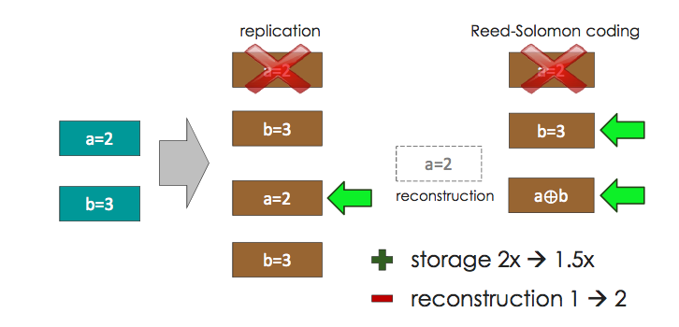
Why pure replication does not scale?
What is the cost of 0.5x of a petabyte? In Oct 2014, about $30K in 1TB disks
Typical data sizes for cloud = Exabytes, potential savings = $30M

Slide 5
Storage: Lets look at the basics
Data

Slide 6
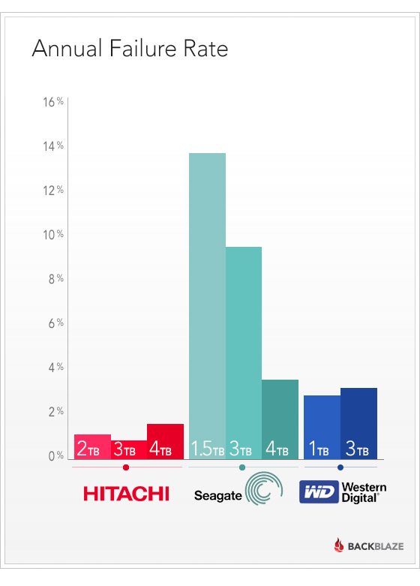
Storage: Basics
Data
Hardware will fail.
With a 2% failure rate, annually a 1PB
data store created from 1TB hard disks
will loose 20 disks a year.
For 100PB failure rate is 2000 discs/year.
This does not cover the End of Life replacement for all the discs every 3 years.
Notes:
https://www.backblaze.com/blog/what-hard-drive-should-i-buy/

Slide 7
Simple Recovery using Parity Codes
Systematic nodes
Parity
nodes
k disks of data
n disks of storage
n= k + m
Allocate some of the disks for storing the parity data
This metadata can be used for recovery in case of failures
Parity data can aide detection and recovery

Slide 8
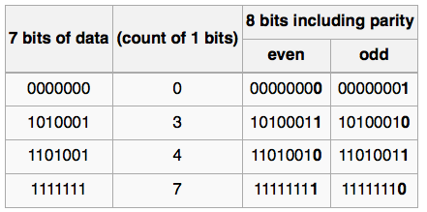
What is parity?
A parity bit, or check bit is a bit added to the end of a string of binary code that indicates whether the number of bits in the string with the value one is even or odd. Parity bits are used as the simplest form of error detecting code.

Slide 9
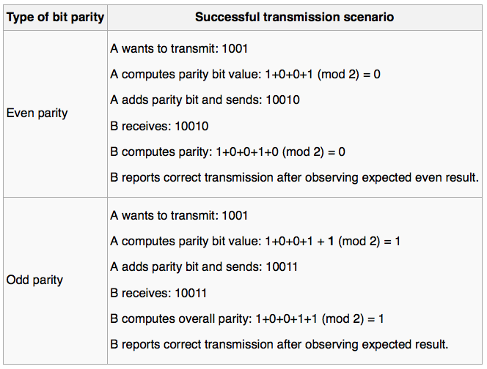
How does parity work?
This is XOR operation
http://en.wikipedia.org/wiki/Parity_bit

Slide 10
How will the parity be used for Recovery?
Assume that we have four disks each storing the data and the fifth disks stores the
even parity bit. Assuming that disk 3 has failed, recreate the contents of the failed
disk from the remaining disks and parity disk.
Disk 1: 0xFE 0xFF 0x10 0x35
Disk 2: 0xAA 0x33 0x1A 0x14
Disk 3: ?? ?? ?? ??
Disk 4: 0x45 0x12 0x11 0x13
Parity: 0x34 0xFF 0x2A 0x26

Slide 11
Partitioning of Parity Blocks
Disk 1: 0xFE 0xFF 0x10 0x35
Disk 2: 0xAA 0x33 0x1A 0x14
Disk 3: 0x25 0x21 0x31 0x14
Disk 4: 0x45 0x12 0x11 0x13
Disk 5: 0x34 0xFF 0x2A 0x26
It is possible to stripe the data and the parity information in such a way that both
reside on the same disc.
Identification of parity blocks can be based on the location of the block or the metadata associated with the block

Slide 12
Horizontal and Vertical Partitioning
Total space required by two schemes is the same
Vertical partitioning allows increased throughput
Horizontal Partitioning
Vertical Partitioning

Slide 13
Recovering from multiple failures: Maximum Distance Separable Codes
r redundancies → correct r erasures
a
b
a+b
a+d
c
d
c+d
c+b+d
a+b
a+d
1st rebuilt block = (c+b+d)-(c+d) = b
2nd rebuilt block = (a+b)-b = a
3rd rebuilt block = (a+d) – a = d
4th rebuilt block = (c+d)-d =c
c+d
c+b+d

Slide 14
Example for calculating the codes
0xFE
0xAA
0x54
0xBB
0x25
0x45
0x60
0xDA
a+b
a+d
1st rebuilt block = (c+b+d)-(c+d) = b= 0xAA
2nd rebuilt block = (a+b)-b = a =0xFE
3rd rebuilt block = (a+d) – a = d = 0x45
4th rebuilt block = (c+d)-d = c = 0x25
c+d
c+b+d

Slide 15
Recovering from single failures
Example for calculating the codes
0xFE
0xAA
0x54
0xBB
0x25
0x45
0x60
0xDA
a
a+b
a+d
1st rebuilt block = (a+b) - a= b= 0xAA
2nd rebuilt block = (c+d)-d = c = 0x25
c
c+d
c+b+d

Slide 16
Recovering from single failures
Example for calculating the codes
r redundancies → correct r erasures
a
b
a+b
a+d
c
d
c+d
c+b+d
How many network accesses are required for regeneration, when a parity node fails?

Slide 17
Recovering from single failures
Cost of Reconstruction?
When parity node fails
Access: # of Access/ # Remaining = 4/6 = 0.66
Bandwidth: # transmission / # Remaining = 3/6 = ½
When systematic node fails
Access: # of Access/ # Remaining = 3/6 = ½
Bandwidth: # transmission / # Remaining = 3/6 = ½

Slide 18
Recovering from single failures
ZigZag Codes
Zigzag Codes: MDS Array Codes With Optimal Rebuilding
@ARTICLE{6352912, author={Tamo, I and Zhiying Wang and Bruck, J.}, journal={Information Theory, IEEE Transactions on}, title={Zigzag Codes: MDS Array Codes With Optimal Rebuilding}, year={2013}, month={March}, volume={59}, number={3}, pages={1597-1616}, }

Slide 19
Recovering from single failures
ZigZag Codes
 | Node-0 | Node-1 | Node-2 | Row sum | Parity-2
0 | a0 | b0 | c0 | a0+b0+c0 | a0+b1+c3
1 | a1 | b1 | c1 | a1+b1+c1 | a1+b3+c0
2 | a2 | b2 | c2 | a2+b2+c2 | a2+b2+c1
3 | a3 | b3 | c3 | a3+b3+c3 | a3+b0+c2

Slide 20
Recovering from single failures
ZigZag Codes
 | Node-0 | Node-1 | Node-2 | Row sum | Parity-2
0 | 0 | 3 | 1 | a0+b0+c0 | a0+b1+c3
1 | 1 | 0 | 2 | a1+b1+c1 | a1+b3+c0
2 | 2 | 2 | 3 | a2+b2+c2 | a2+b2+c1
3 | 3 | 1 | 0 | a3+b3+c3 | a3+b0+c2
 | Node-0 | Node-1 | Node-2 | Row sum | ZigZag sum
0 | 0 | 3 | 1 | r0 | z0
1 | 1 | 0 | 2 | r1 | z1
2 | 2 | 2 | 3 | r2 | z2
3 | 3 | 1 | 0 | r3 | z3

Slide 21
Recovering from single failures
ZigZag Codes
 | Node-0 | Node-1 | Node-2 | Row sum | ZigZag sum
0 | 0 | 3 | 1 | r0 | z0
1 | 1 | 0 | 2 | r1 | z1
2 | 2 | 2 | 3 | r2 | z2
3 | 3 | 1 | 0 | r3 | z3
Requires 12 accesses to recreate the dataset on node0

Slide 22
Recovering from single failures
ZigZag Codes
 | Node-0 | Node-1 | Node-2 | Row sum | ZigZag sum
0 | 0 | 3 | 1 | r0 | z0
1 | 1 | 0 | 2 | r1 | z1
2 | 2 | 2 | 3 | r2 | z2
3 | 3 | 1 | 0 | r3 | z3
Naïve read requires 12 accesses to recreate the dataset on node0
Smart read requires 8 accesses

Slide 23
Recovering from single failures
ZigZag Codes
 | Node-0 | Node-1 | Node-2 | Row sum | ZigZag sum
0 | 0 | 3 | 1 | r0 | z0
1 | 1 | 0 | 2 | r1 | z1
2 | 2 | 2 | 3 | r2 | z2
3 | 3 | 1 | 0 | r3 | z3
Naïve read requires 12 accesses to recreate the dataset on node0
Smart read requires 9 accesses

Slide 24
Recovering from single failures
ZigZag Codes
 | Node-0 | Node-1 | Node-2 | Row sum | ZigZag sum
0 | 0
1 | 1
2 | 2
3 | 3
Permutations
Four rows three columns
Column 0 : identity permutation
Column I : Flip i^{th} bit of the index
From msb
0
1
2
3
00
01
10
11
10
11
00
01
2
3
0
1

Slide 25
Recovering from single failures
ZigZag Codes
 | Node-0 | Node-1 | Node-2 | Row sum | ZigZag sum
0 | 0 | 2
1 | 1 | 3
2 | 2 | 0
3 | 3 | 1
Permutations
Four rows three columns
Column 0 : identity permutation
Column I : Flip i^{th} bit of the index
From msb
0
1
2
3
00
01
10
11
01
00
11
10
1
0
3
2

Slide 26
Recovering from single failures
ZigZag Codes
 | Node-0 | Node-1 | Node-2 | Row sum | ZigZag sum
0 | 0 | 2 | 1
1 | 1 | 3 | 0
2 | 2 | 0 | 3
3 | 3 | 1 | 2
Permutations
Four rows three columns
Column 0 : identity permutation
Column I : Flip i^{th} bit of the index
From msb
0
1
2
3
00
01
10
11
01
00
11
10
1
0
3
2

Slide 27
Recovering from single failures
ZigZag Codes
 | Node-0 | Node-1 | Node-2 | Row sum | ZigZag sum
0 | m | a | w | m+a+w | 2m+c+2z
1 | n | b | x | n+b+x | 2n+d+y
2 | p | c | y | p+c+y | p+a+x
3 | q | d | z | q+d+z | q+b+2w
Access v/s Bandwidth
For M rows
 | Optimal Access | Optimal Bandwidth
Optimal Update | M+1 | M+1
Non-optimal update | 3m<k<2^{2m} (More) | 2M (Less)

Slide 28
References
Extending striping scheme to recover from failure of multiple devices.
https://www.usenix.org/legacy/publications/library/proceedings/fast04/tech/corbett/corbett_html/

